Slide 1
COMPANY ANALYSIS
LUCY ADHIAMBO
INFO TECH INTERN

Slide 2
Introduction
As an intern, I am tasked with analyzing the employee data of a company to gain insights into various aspects of its workforce.
The dataset provided contains information about employees, their departments, salaries, titles, and managerial positions.

Slide 3
Data Set Description
emp_no; Employee Number
birth_date; Date of Birth
first_name; First Name
last_name; Last Name
gender; Gender
hire_date; Hire Date
dept_no; Department number
dep_name; Department name

Slide 4
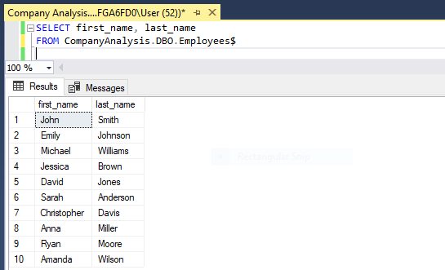
1. Retrieve the first name and last name of all employees.

Slide 5
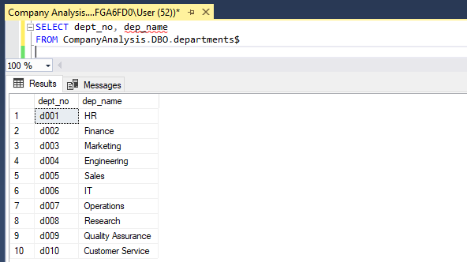
2. Find the department numbers and names.

Slide 6
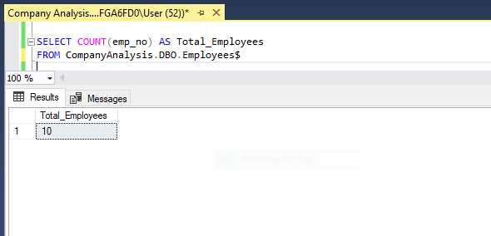
3. Get the total number of employees.

Slide 7
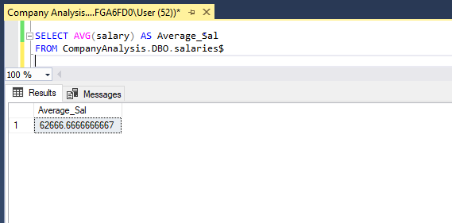
4. Find the average salary of all employees

Slide 8
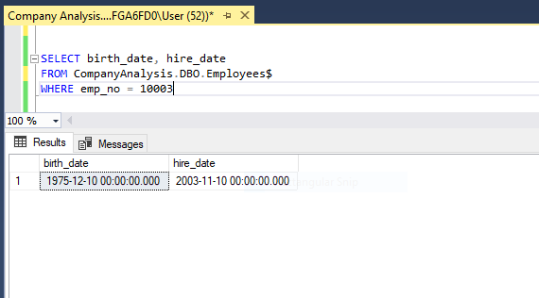
5. Retrieve the birth date and hire date of employee with emp_no 10003.

Slide 9
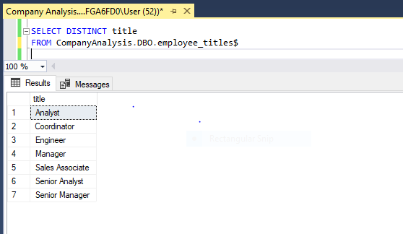
6. Find the titles of all employees.

Slide 10
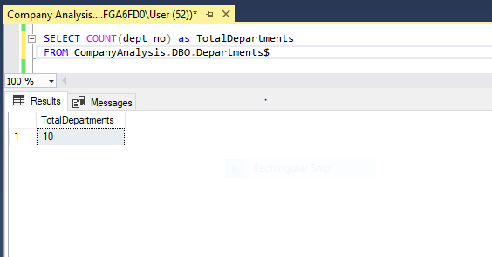
7. Get the total number of departments.

Slide 11
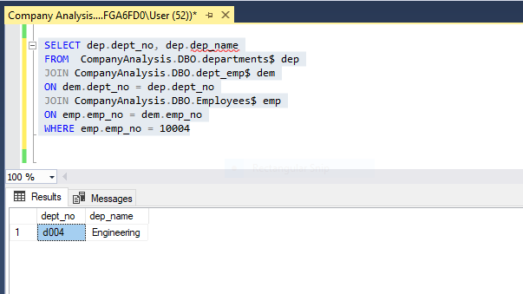
8. Retrieve the department number and name where employee with emp_no 10004 works.

Slide 12
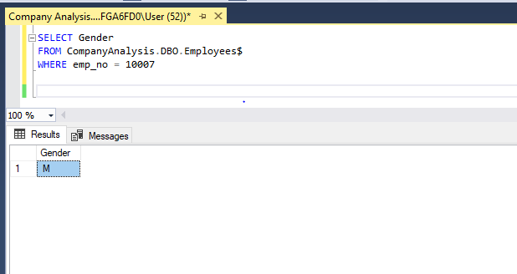
9. Find the gender of employee with emp_no 10007.

Slide 13
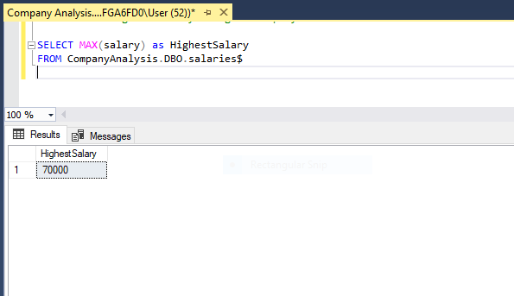
10. Get the highest salary among all employees

Slide 14
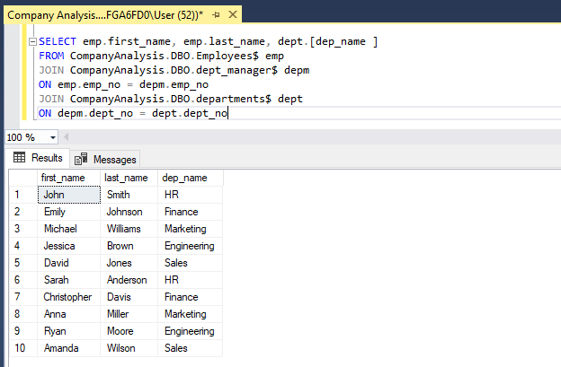
11. Retrieve the names of all managers along with their department names.

Slide 15
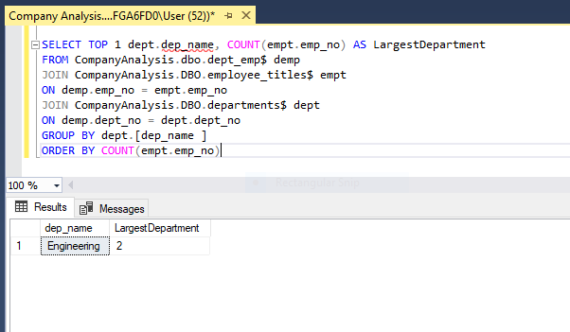
12. Find the department with the highest number of employees.

Slide 16
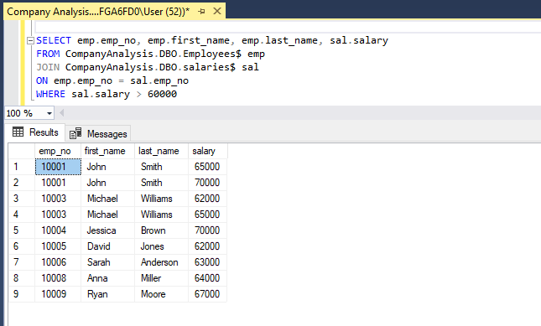
13. . Retrieve the employee number, first name, last name, and salary of employees earning more than $60,000

Slide 17
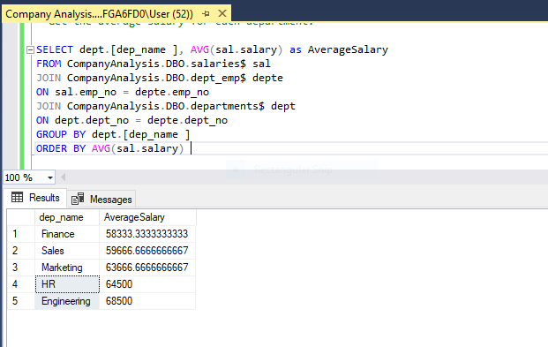
14. Get the average salary for each department.

Slide 18
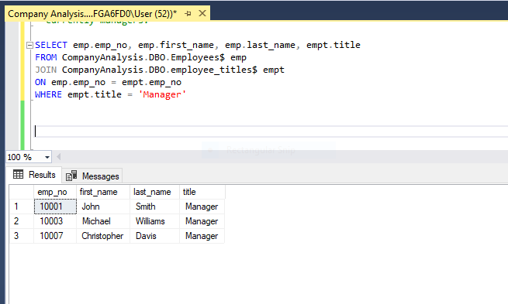
15. Retrieve the employee number, first name, last name, and title of all employees who are currently managers.

Slide 19
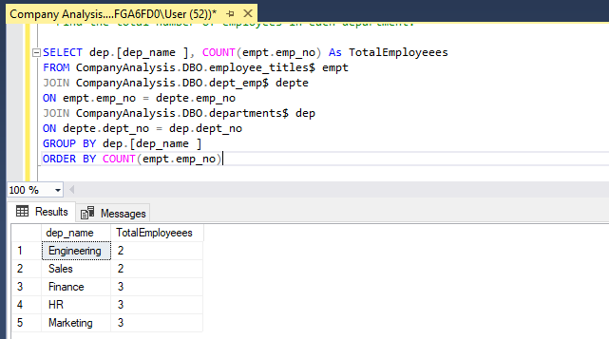
16. Find the total number of employees in each department.

Slide 20
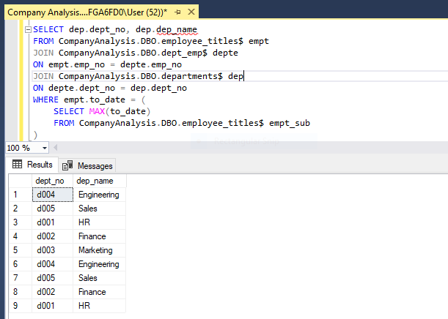
17. Retrieve the department number and name where the most recently hired employee works.

Slide 21
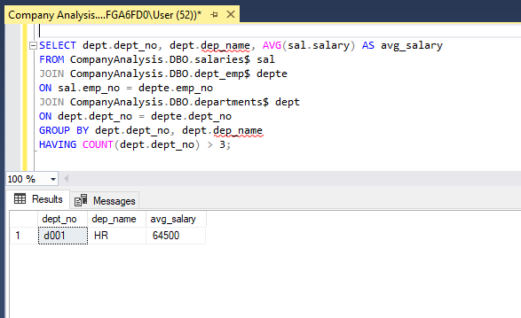
18. Get the department number, name, and average salary for departments with more than 3 employees.

Slide 22
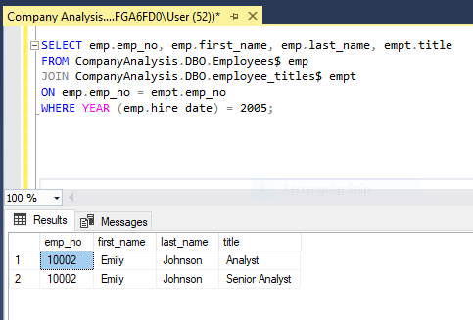
19. Retrieve the employee number, first name, last name, and title of all employees hired in 2005.

Slide 23
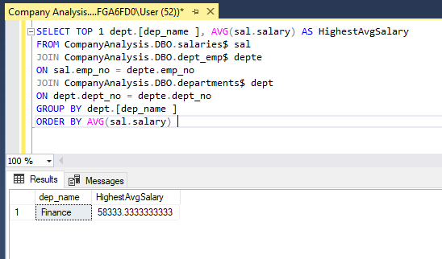
20. Find the department with the highest average salary.

Slide 24
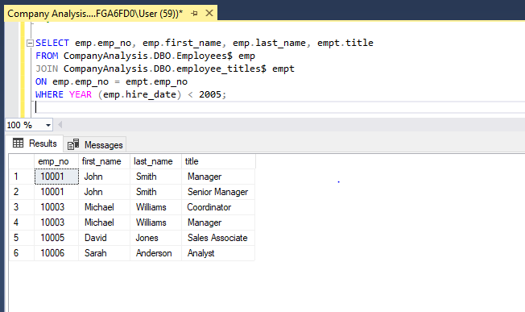
21. Retrieve the employee number, first name, last name, and salary of employees hired before the year 2005.

Slide 25
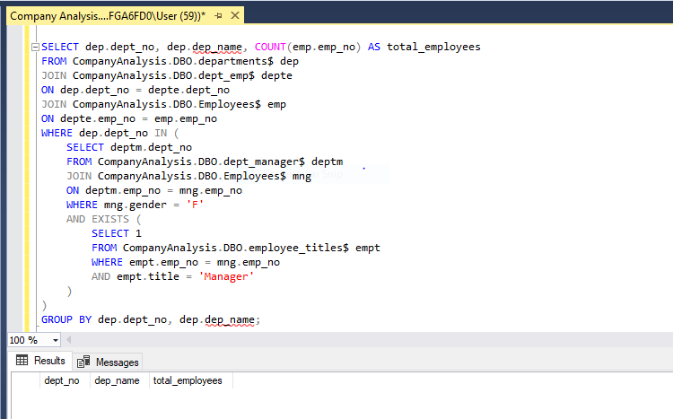
22. Get the department number, name, and total number of employees for departments with a female manager.

Slide 26
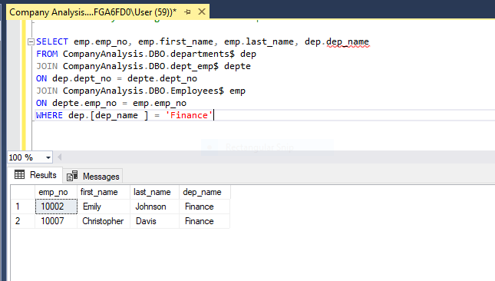
23. Retrieve the employee number, first name, last name, and department name of employees who are currently working in the Finance department.

Slide 27
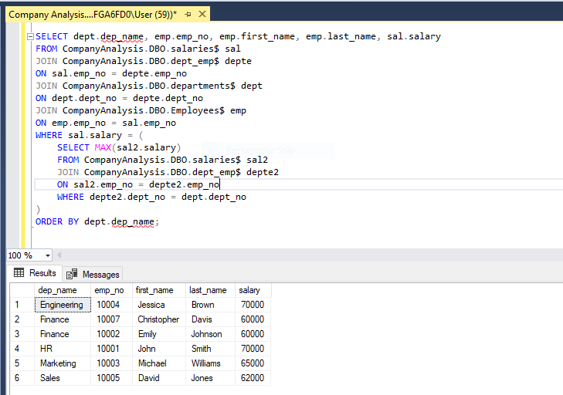
24. Find the employee with the highest salary in each department.

Slide 28
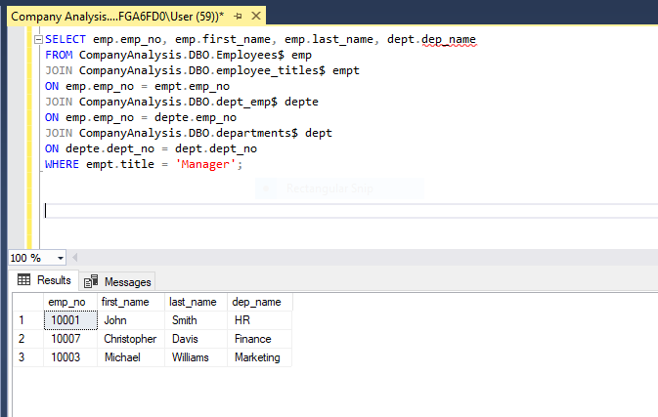
25. Retrieve the employee number, first name, last name, and department name of employees who have held a managerial position.

Slide 29
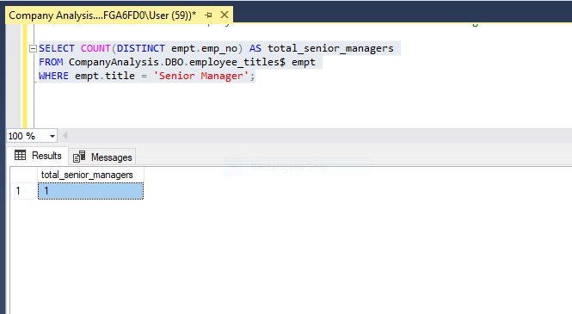
26. Get the total number of employees who have held the title "Senior Manager."

Slide 30
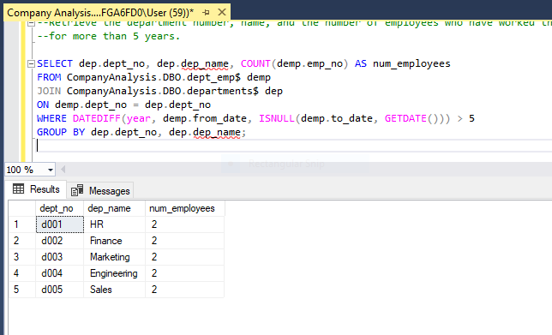
27. Retrieve the department number, name, and the number of employees who have worked there for more than 5 years.

Slide 31
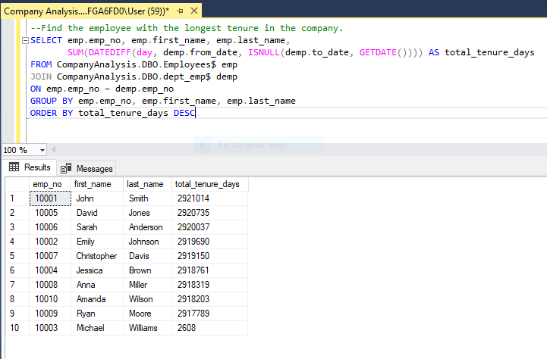
28. Find the employee with the longest tenure in the company.

Slide 32
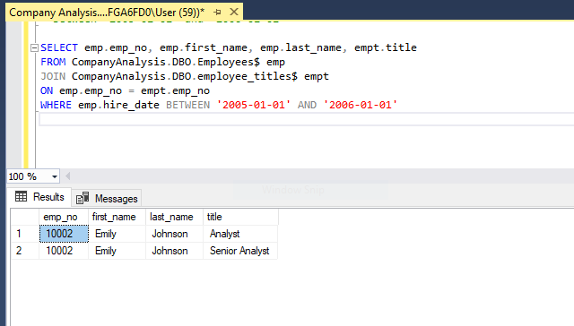
29. Retrieve the employee number, first name, last name, and title of employees whose hire date is between '2005-01-01' and '2006-01-01'

Slide 33
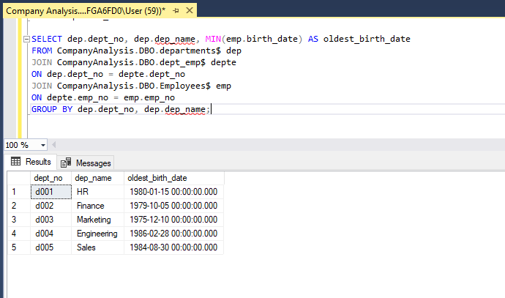
30 Get the department number, name, and the oldest employee's birth date for each department.

Slide 34
THANK YOU
.

